Slide 1
Coordinator
Beacon
Timer
Expire
appInit
Config
Beacon
Timer
Config
Beacon
Timer
Beacon Interval = 4s
Active Period = 0.5s
Final CAP Slot = 30ms
Wait
Beacon
Timer

Slide 2
Non Collaborative Device
Beacon Interval – 50ms
Beacon
Timer
Expire
Receive Beacon
TDMA Slot
Expire
appInit
FromSleep?
Prepare Data
Goto Sleep
Send Data
Goto Sleep
Config
Device
Timers
Yes
Slot time
Wake-Up &
Wait
Idle
Sleep
Sleep
Infinite time

Slide 3
Collaborative Device
Beacon Interval – 50ms
Beacon
Timer
Expire
Receive Beacon
TDMA Slot
Expire
Active Period –
Slot Time
COLAB
Slot
Expire
Active Period +
Slot time
TDMA Slot
Expire
appInit
Prepare Data
Config Data Slot
Config Collab
Options
FromSleep?
Send Data
Configure
Collab TDMA Slot
Send Compressed Data
Config
Device
Timers
Yes
Slot time
Wake-Up &
Wait
I am Collab?
I am Collab?
Compress
Data
Sleep
Idle
Sleep
Sleep
Infinite time
Sleep
Yes
Yes
Receive
Neighbor's

Slide 4
BI 3.93216s
30.72ms
50.00ms x 8
BEACON
CAP
Slot 1
Slot 2
Slot 3
Slot 4
Slot 5
Slot 6
Slot 7
Slot 8
Data
Compression
Slot 1
Slot ..
Slot 8
BEACON
50.00ms
Active Period 0.49152s
Inactive Period 3.44064s

Slide 5
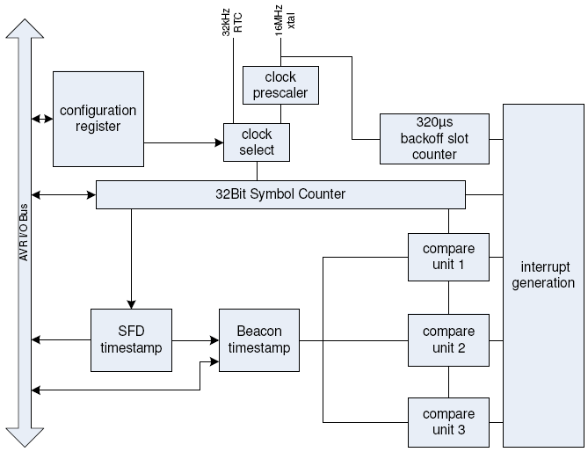

Slide 6
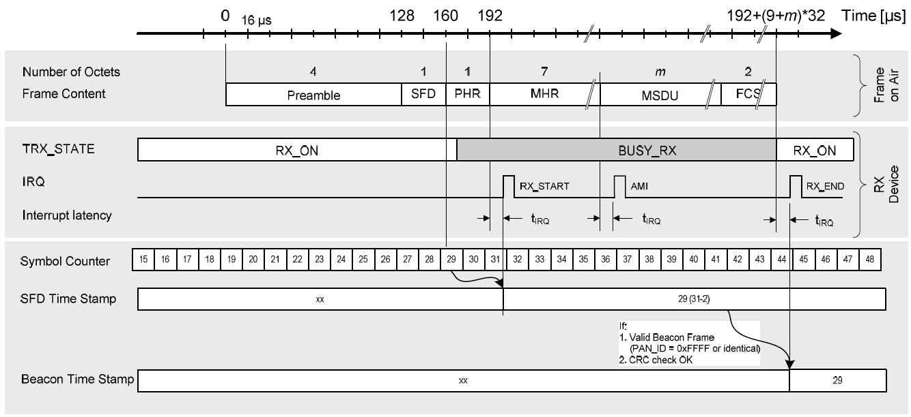

Slide 7
